Slide 1
CSE 4228 Digital Image Processing
Final Assignment

Slide 2
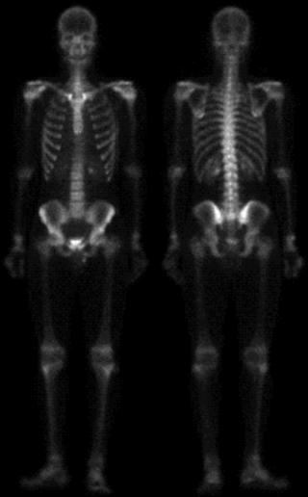
Step 1:
Take the Input image.
Display it (Figure a).
Figure (a)

Slide 3
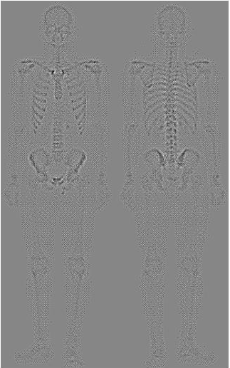
Step 2:
Apply Laplacian Filter in image (a).
Take the positive Laplacian mask, where the absolute value of the central pixel is 4.
Use imshow command in this step as follows:
imshow(I,[ ]);
The output image should look like figure (b).
Don’t forget to handle pixel boundaries where necessary in each step!!!
Figure (b)

Slide 4
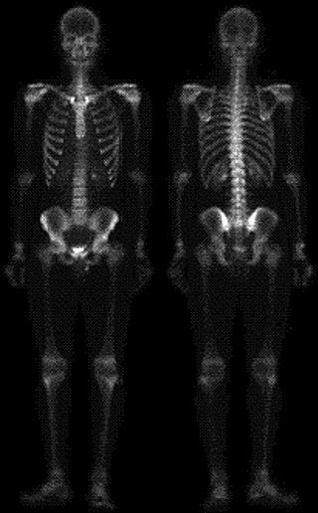
Step 3:
Do necessary Operations to get the Laplacian Enhanced Image (c).
Hint: Try to remember how to get Laplacian enhanced image if we use a positive Laplacian Mask!!!
Figure (c)

Slide 5
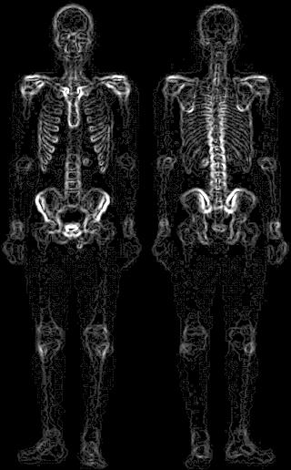
Step 4:
Apply Sobel Filter on Image (a).
Your output (Sobel Filtered Image) should look like (d).
Figure (d)

Slide 6
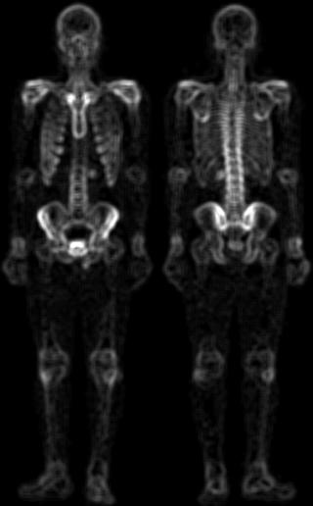
Step 5:
Design a 5X5 average filter mask.
Apply it to image (d).
Your output should look like (e).
Figure (e)

Slide 7
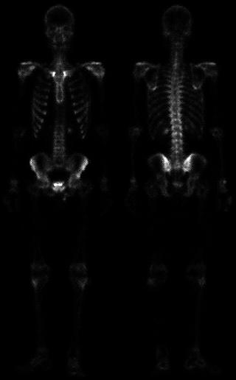
Step 6:
Get the product of (c) and (e).
Your output should look like (f).
Figure (f)

Slide 8
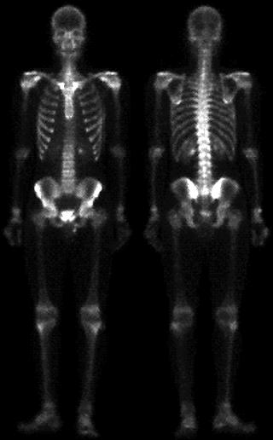
Step 7:
Add (a) and (f).
Your output should look like (g).
Figure (g)

Slide 9
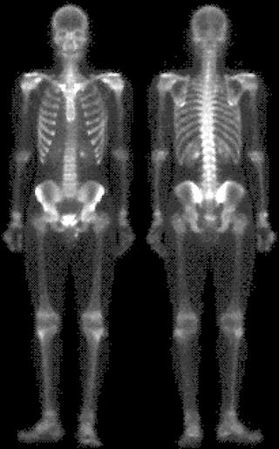
Step 8:
Apply Power Law Transform.
Use c=1 and Gamma=0.5.
Your output should look like (h).
Figure (h)

Slide 10
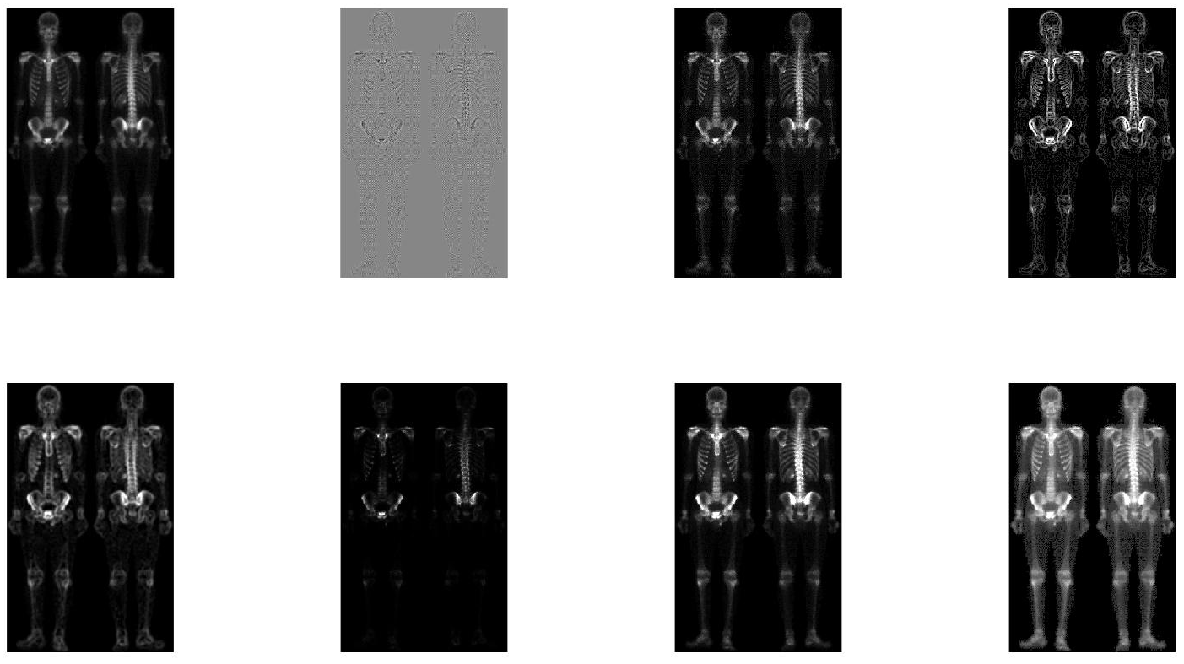
Now Subplot them and Submit Your Code !!!

